Slide 1
Sorted([5,4,3],Final)
qmain([4,5,3])
parent
qsorter([4,5,3],Final)
become
Sorted([5],Left)
qwaiter(4,Final)
Sorted([3],Left)
parent
parent
new
new
qsorter([5],Left)
qsorter([3],Right)
become
become
Sorted([],Left)
qwaiter(5,Left)
Sorted([],Right)
Sorted([],Left)
qwaiter(5,Left)
Sorted([],Right)
parent
parent
parent
parent
qsorter([],Left)
qsorter([],Left)
qsorter([],Left)
qsorter([],Left)

Slide 2
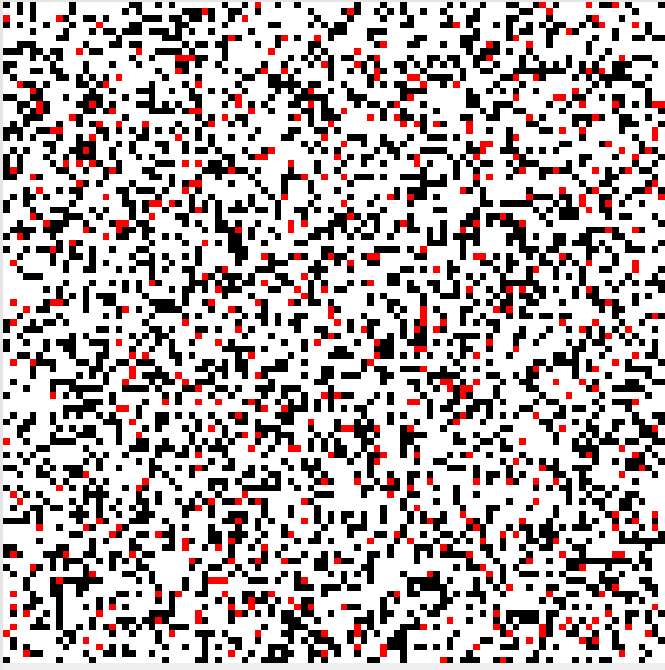
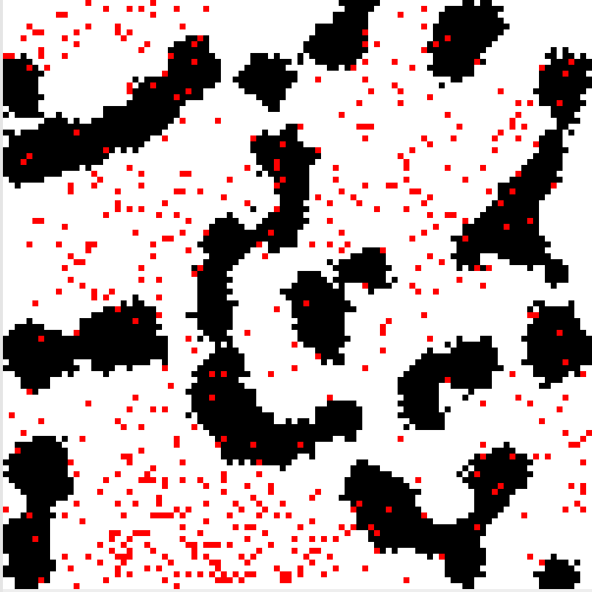
Emergent Behaviour: Termites!

Slide 4
Map/Group/Reduce
Data
Map
KV[K,V]
Group
X
Reduce
Y
X
Map
KV[K,V]
KV[K,[V]]
Reduce
Y
X
Map
KV[K,V]
Reduce
Y
X
Map
KV[K,V]

Slide 5
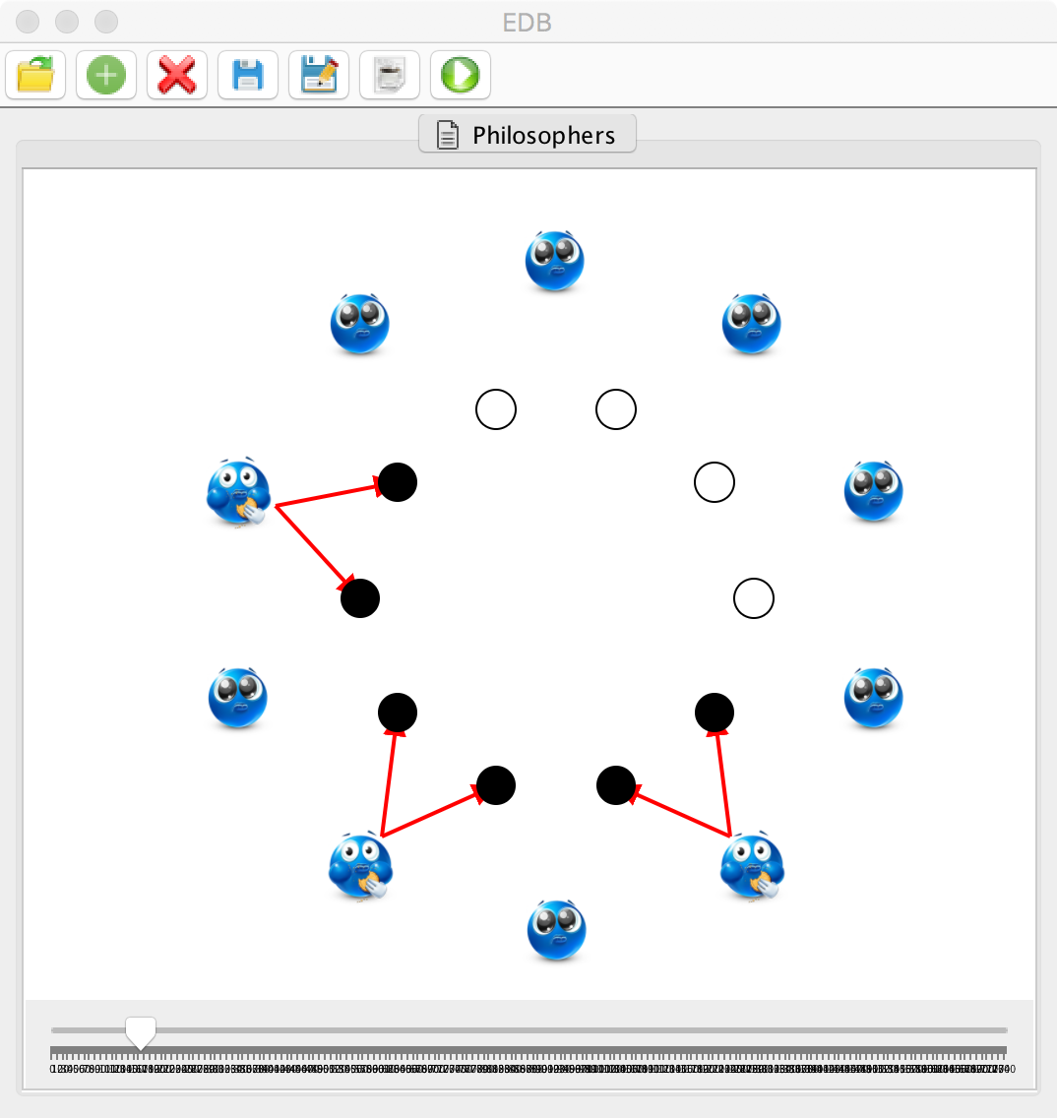
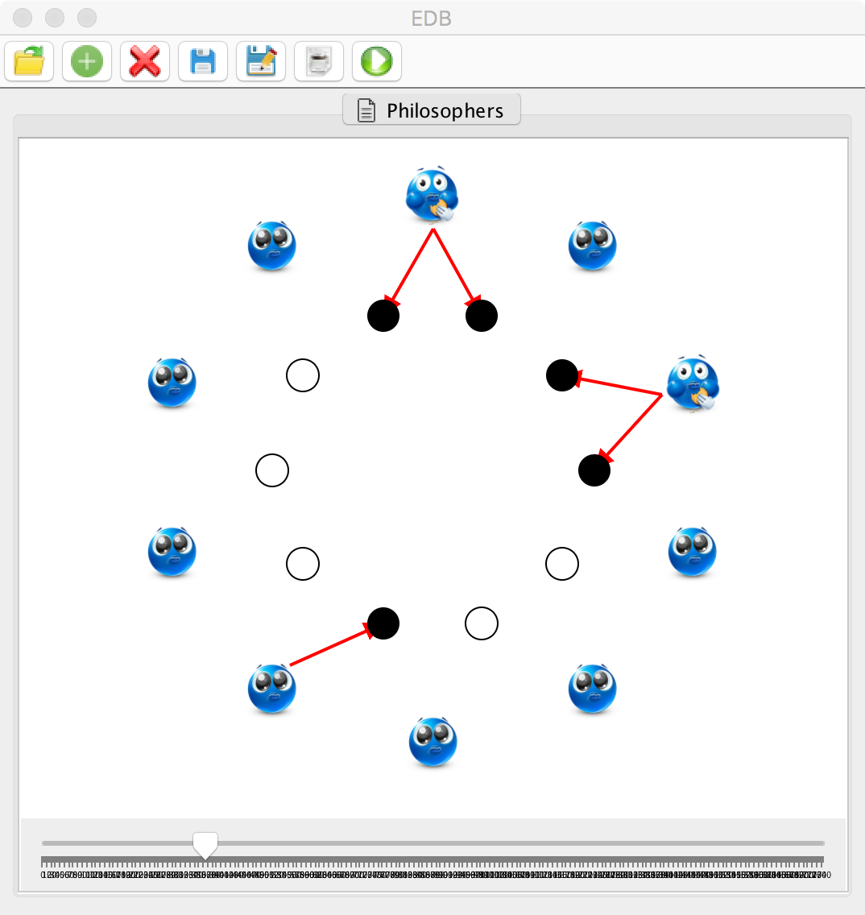
Filmstrips: Dining Philosophers
data Action =
Grab(Int,Chopstick)
| Release(Chopstick);
history :: [ Action ];
data Hold = Holds(Int,[Chopstick]);
data Snap = Snapshot([Hold],[Chopstick]);
filmstrip(history::[Action])::[Snap];
toPictures(filmstrip::[Snap])::Displays;
type Displays = [EDBDisplay];
data EDBDisplay =
Picture(Int,Int,[PictureElement]);
data PictureElement =
Rectangle(Int,Int,Int,Int,Str),
| Circle(Int,Int,Int,Str),
| Line(Int,Int,Int,Int,Str),
| Image(Int,Int,Int,Int,Str),
| Text(Int,Int,Str,Str);

Slide 6
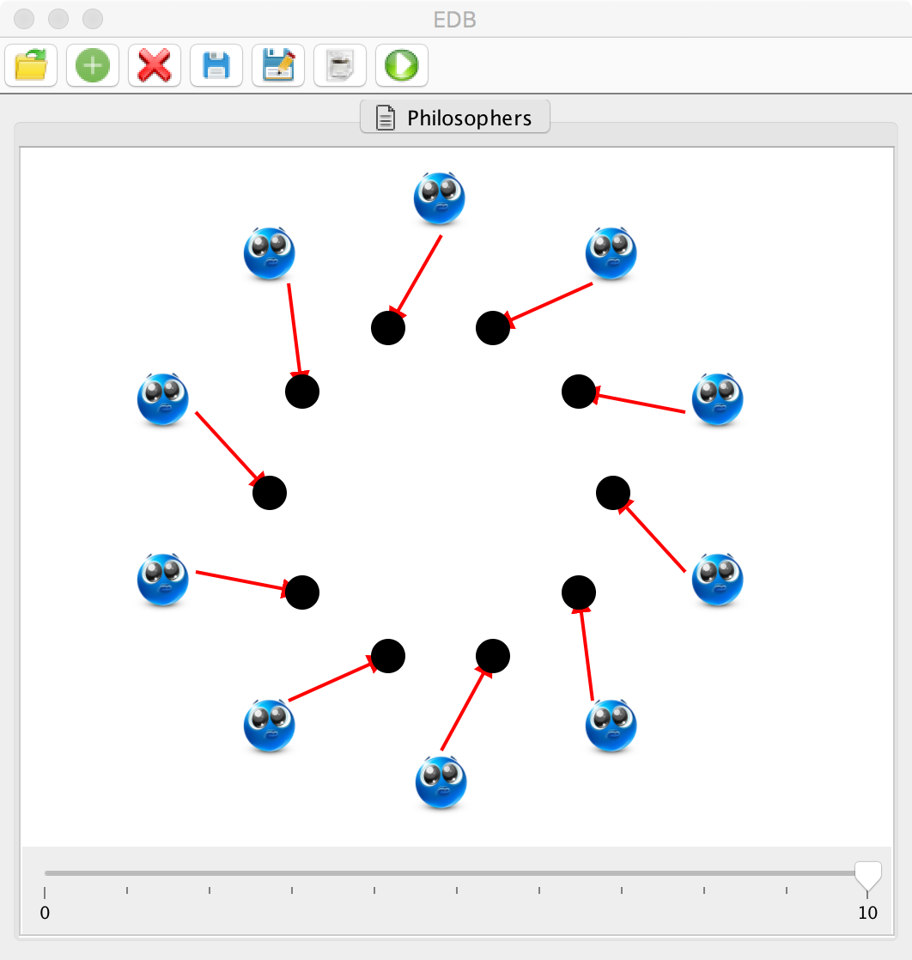

Slide 7
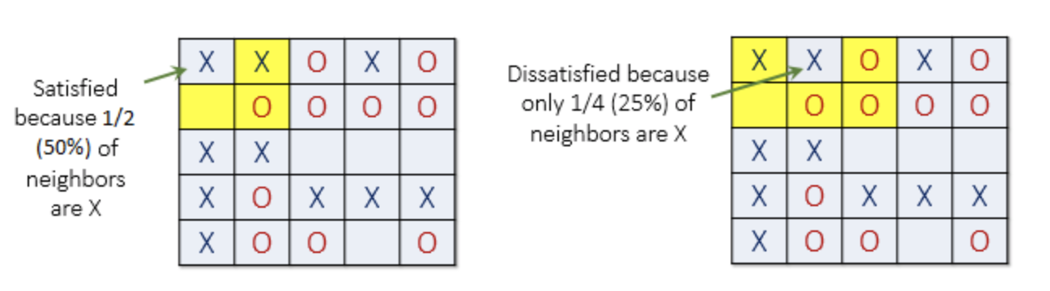
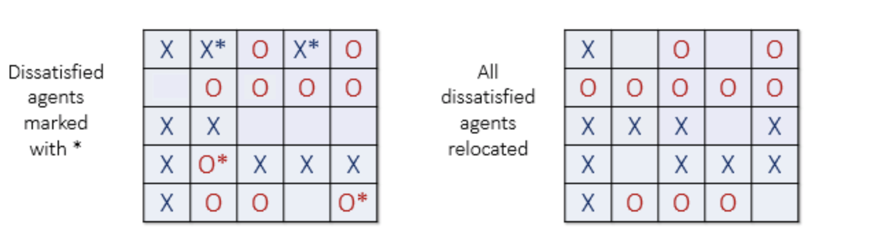
Satisfaction and Relocation
http://nifty.stanford.edu/2014/mccown-schelling-model-segregation/

Slide 8
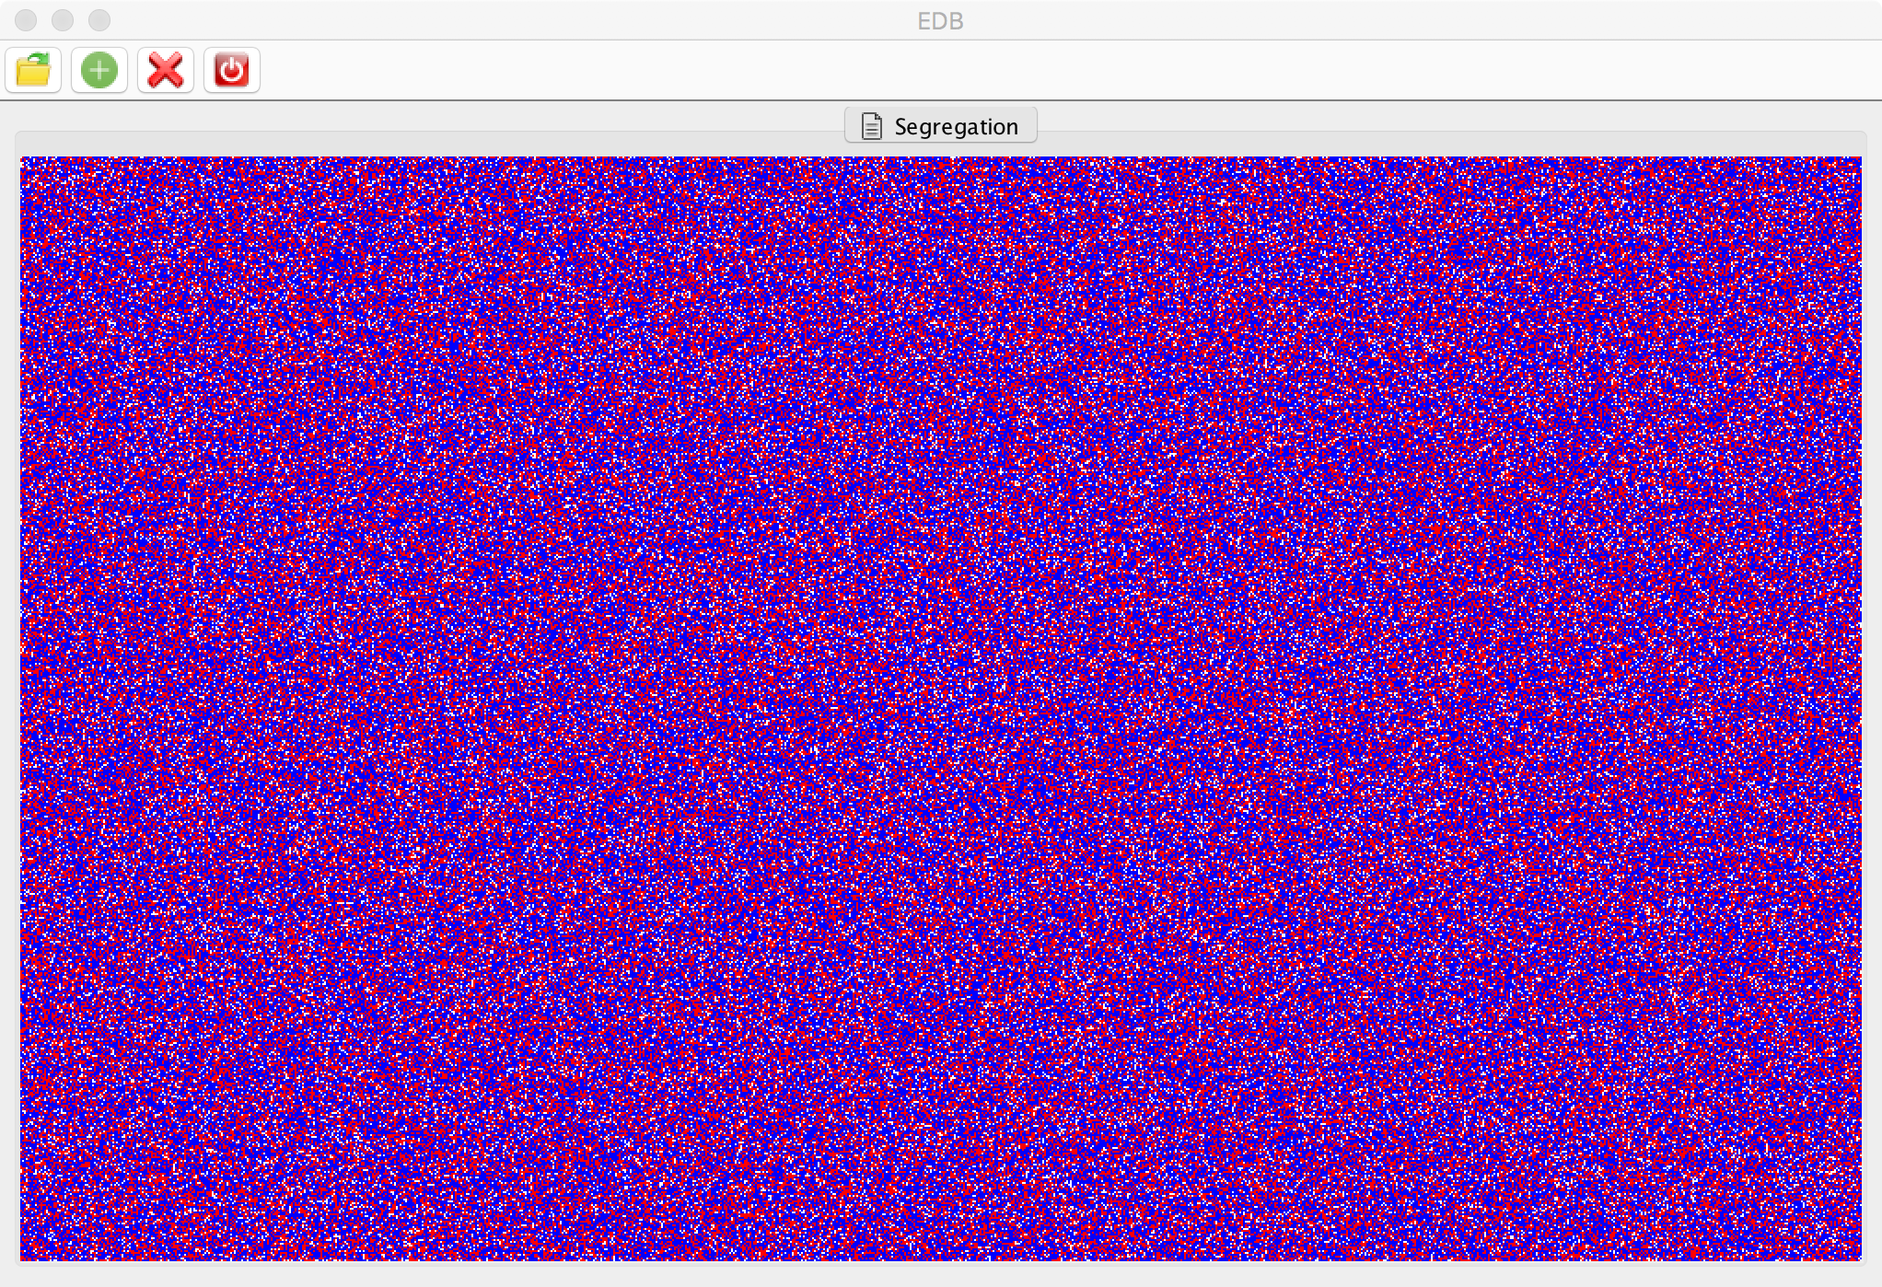

Slide 9
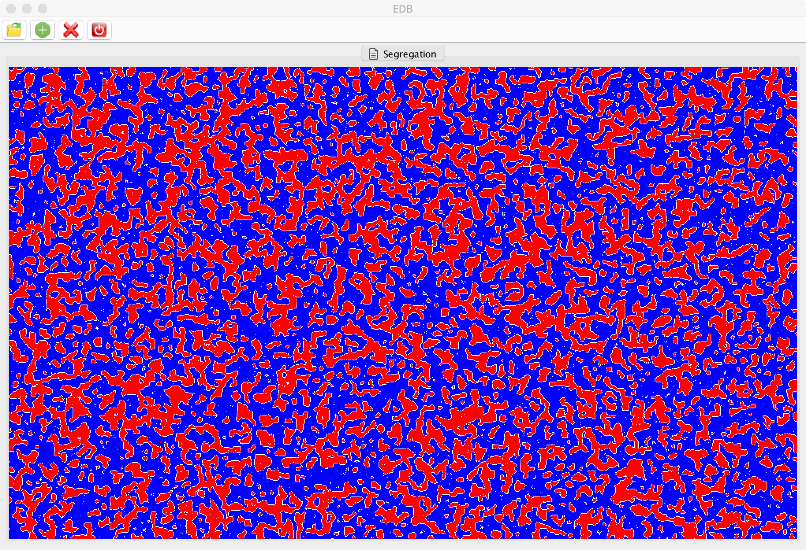

Slide 10
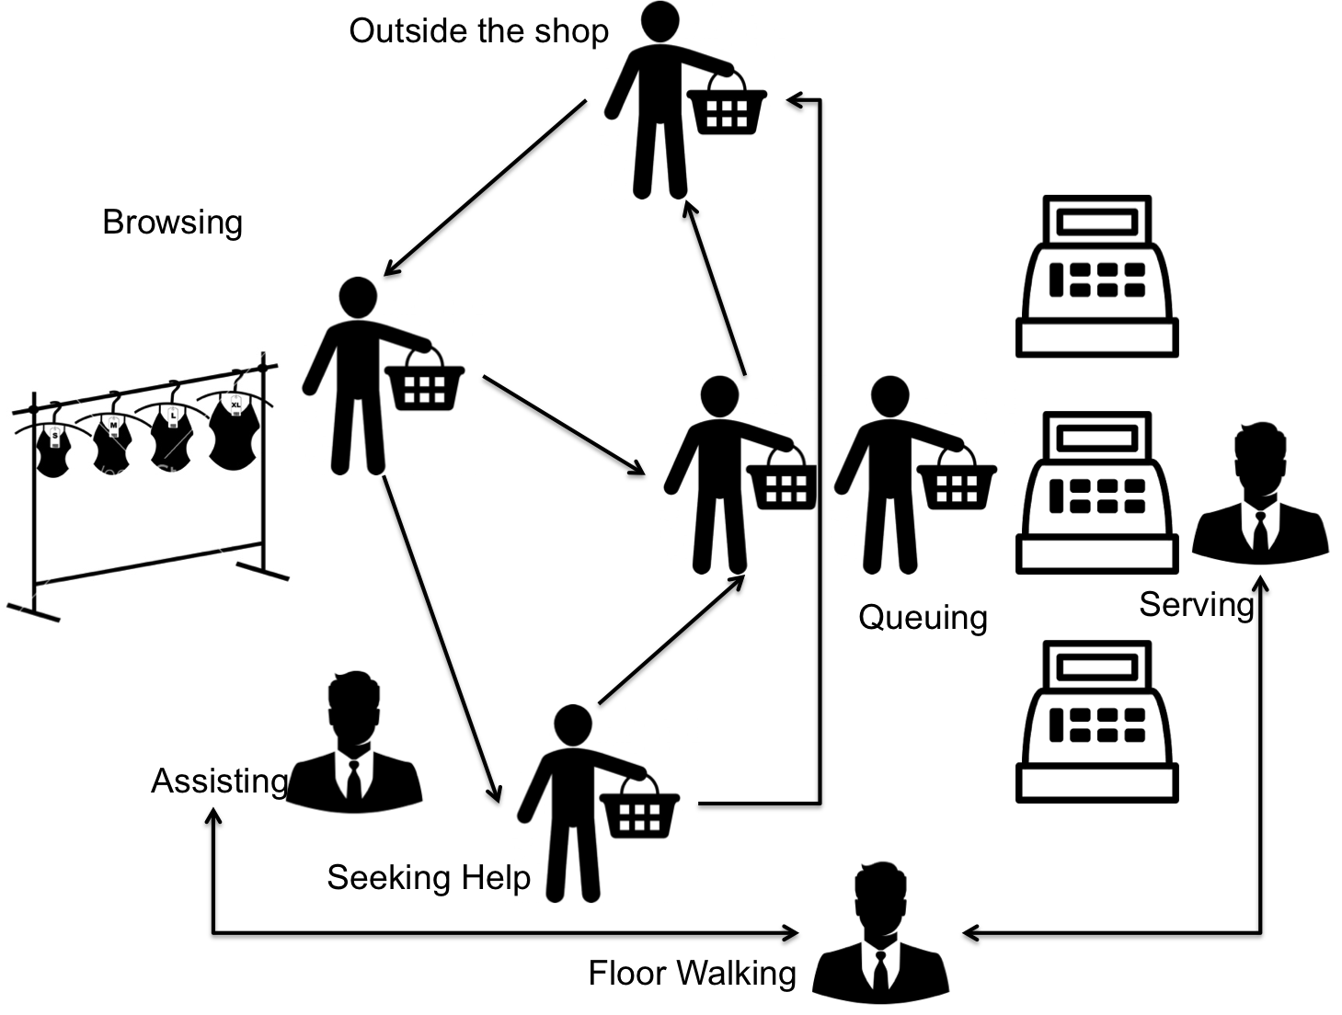
Simulation: A Shop
data Property = Prop(Str,Str);
type Props = [Property];
data TRow[T] = Row(Props,[TData[T]]);
data TData[T] = Data(Props,T);
data EDBDisplay =
HTML(Str)
| Table(Props,[TRow[EDBDisplay]]);
data CustomerDisplay = C(Int,Str,[Str],Int,Int);
customers::[CustomerDisplay];
Act Display {
// Each command updates customers list...
RegisterCustomer(Int,Str,[Str]);
ChangeState(Int,Str);
Sale(Int);
TimeOut(Int);
}
totable::([Customers]) -> EDBDisplay;

Slide 11
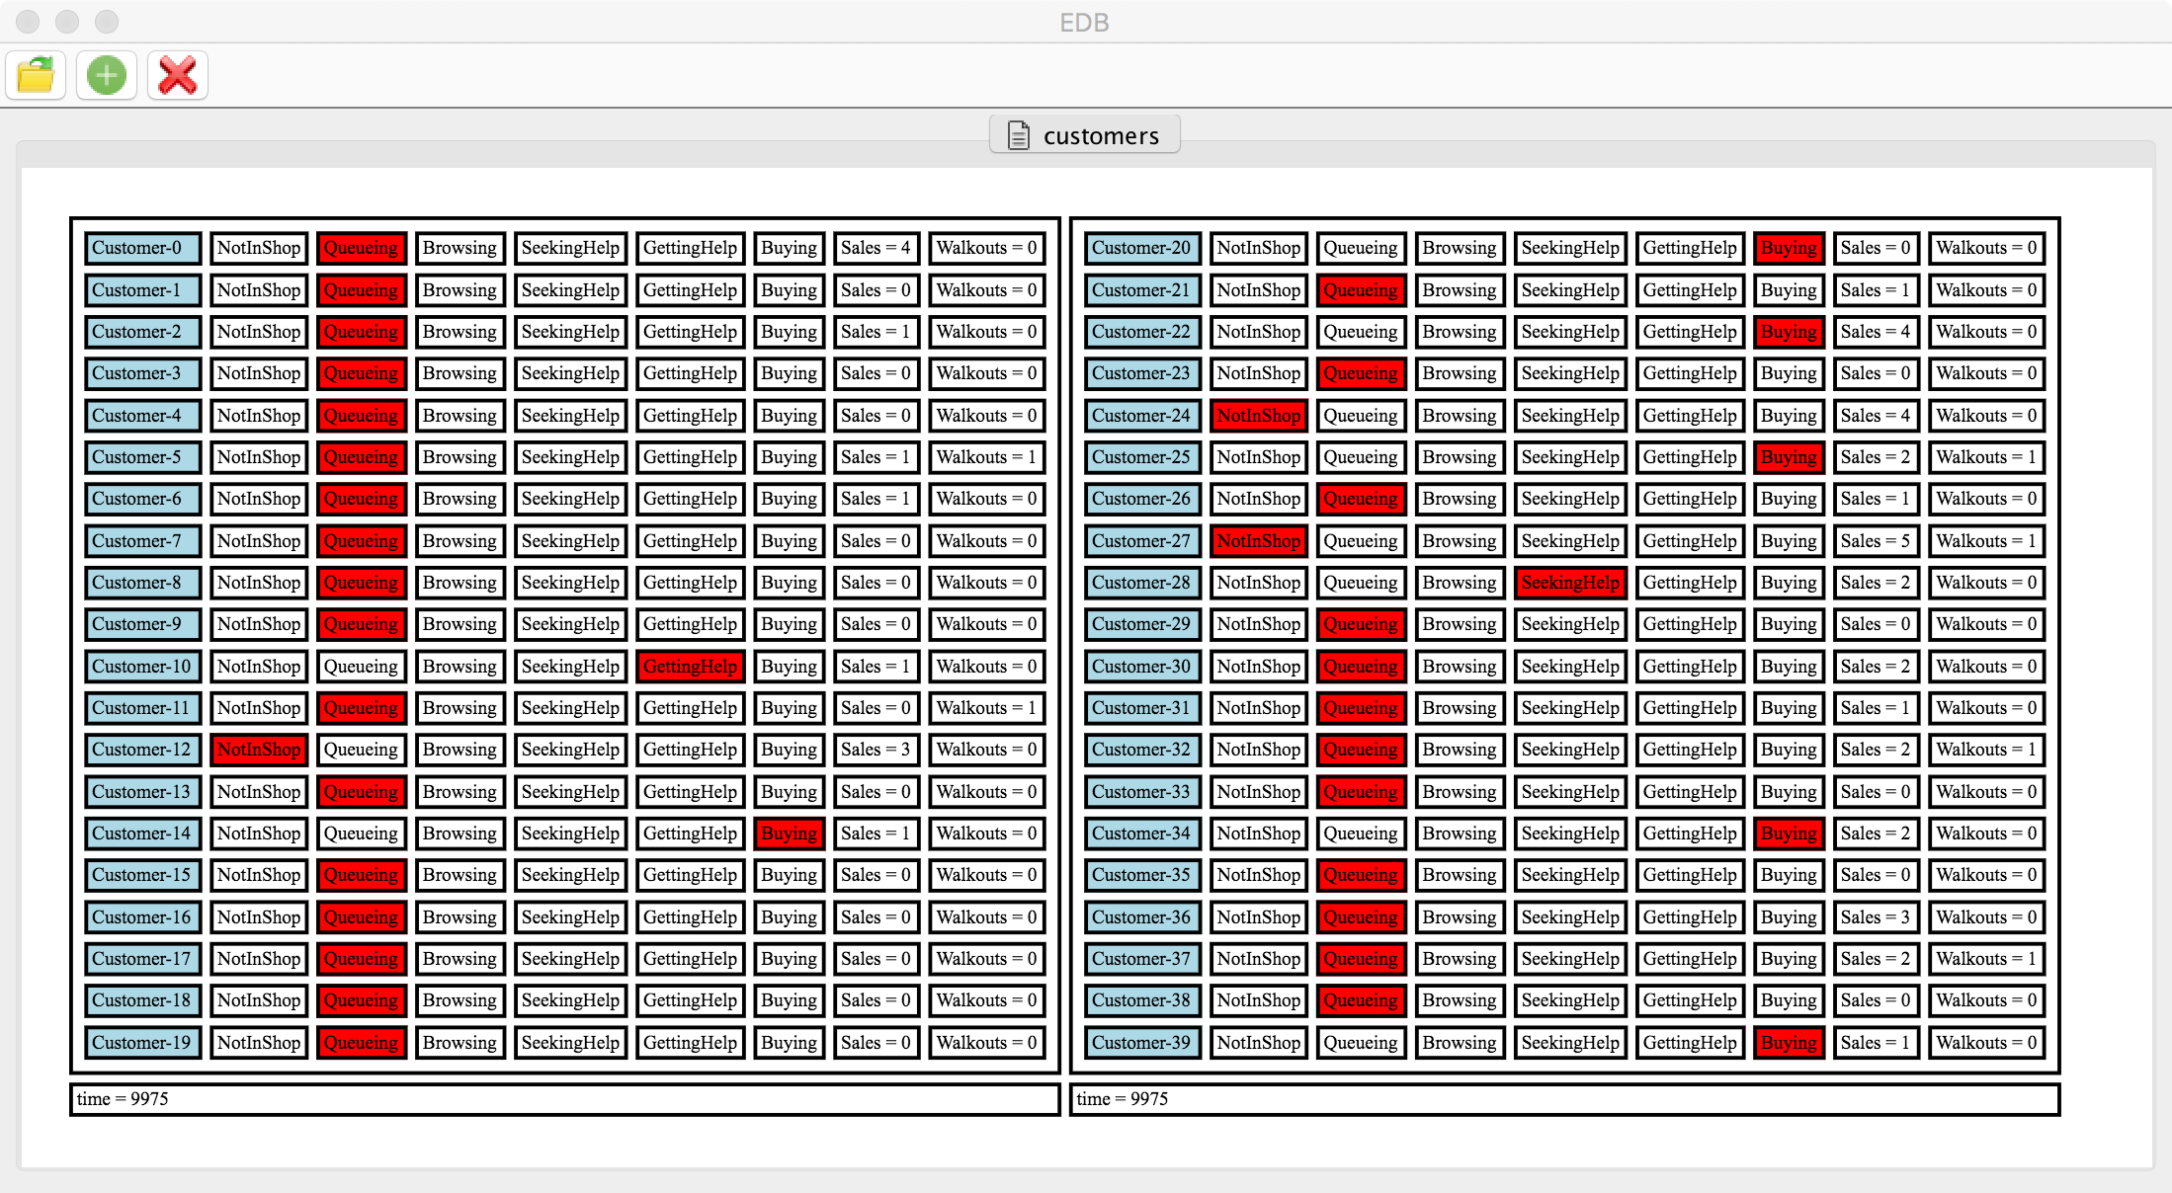

Slide 12
